Slide 1
Scaling Machine Learning with Cloud Computing
Luca Fontanili
FabLab Parma, 27/10/2018

Slide 2
From On-Premise
To Cloud Computing

Slide 3
On-Premise solutions
Software installed on user's PC
We control everything
We (the final user) have to deal with all of the issues of our PC (hardware, networking, software installation etc)
Hard to scale
Upfront capital expenditure
Useless most of the time
Notes:
Lavoro in ambito Big Data da anni, e abbiamo cluster con centinaia e centinaia di GB di memoria; se dovessi acquistare un PC con queste caratteristiche sarebbe inaccessibile, inoltre, per la maggior parte del tempo, non sarebbe nemmeno utile.

Slide 4
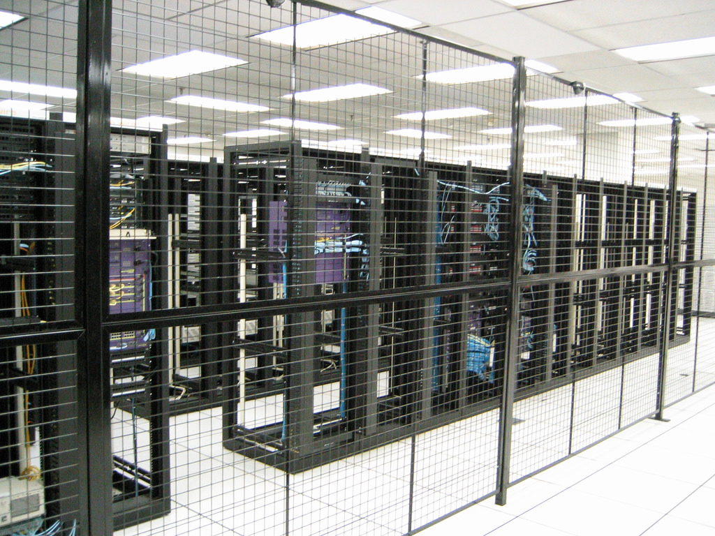
Data center
House to huge amount of single computer systems and related components
Wired together
No Network issues, always updated, redundant/backup components

Slide 5
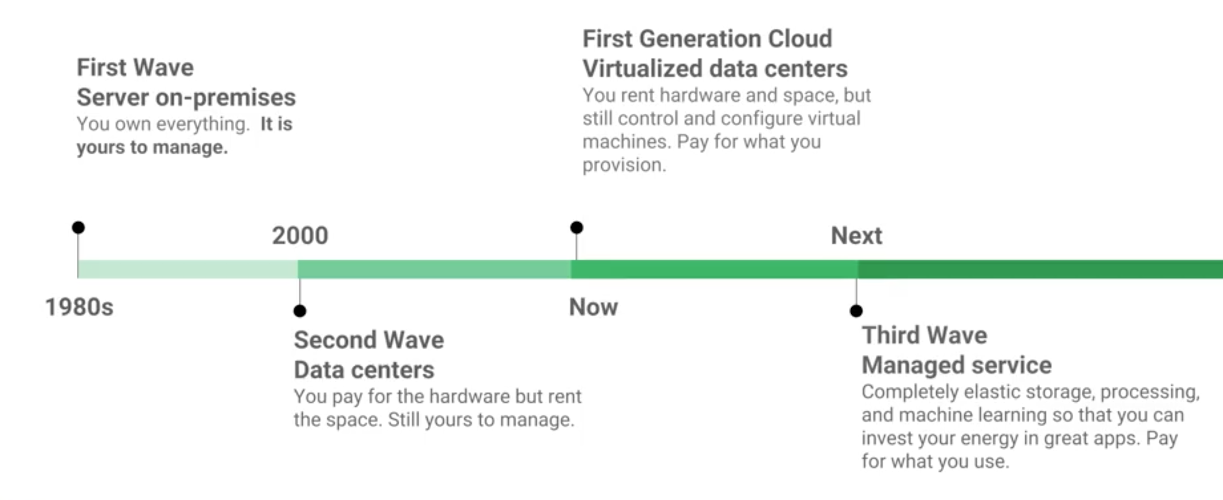
Cloud solutions
Software hosted on third-party vendors machines
Typically accessed via HTTP
Pay as you go
Elastic computing (buying 1k machines on-premise is too expensive; using 1k macchine in cloud for a few hours/days is just fine)

Slide 6
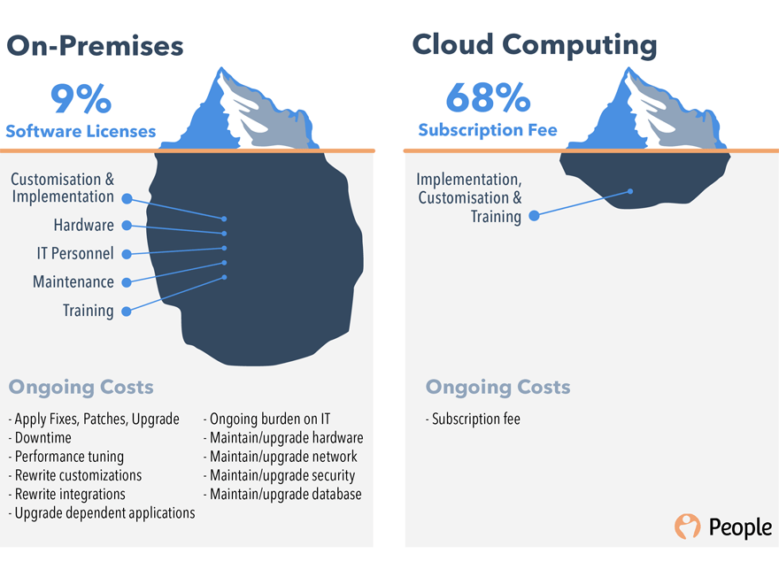
Cost comparison

Slide 7
Biggest Pros of Cloud Computing
It's cheaper
It has more flexibility
It has more scalability, reliability
It provides you with lot of Innovation
Approaching "The Cloud"
Just migrate to the cloud (where)
Innovation: software Google provides (how)

Slide 8
The state of the art
Nowadays we can move to the cloud in many different ways (with many different costs):
CRM hosting (just software, no access to machines; e.g. Aruba WP Hosting)
Oracle VM (tool to manage single VM instances on a private data center)
VMs hosting (access to a VM; e.g. Amazon AWS, Google GCP)
Some Cloud Computing providers offers different software packages to interact with within the VM (S3, Cloud DataFlow, Glacier, Google BigTable)

Slide 9
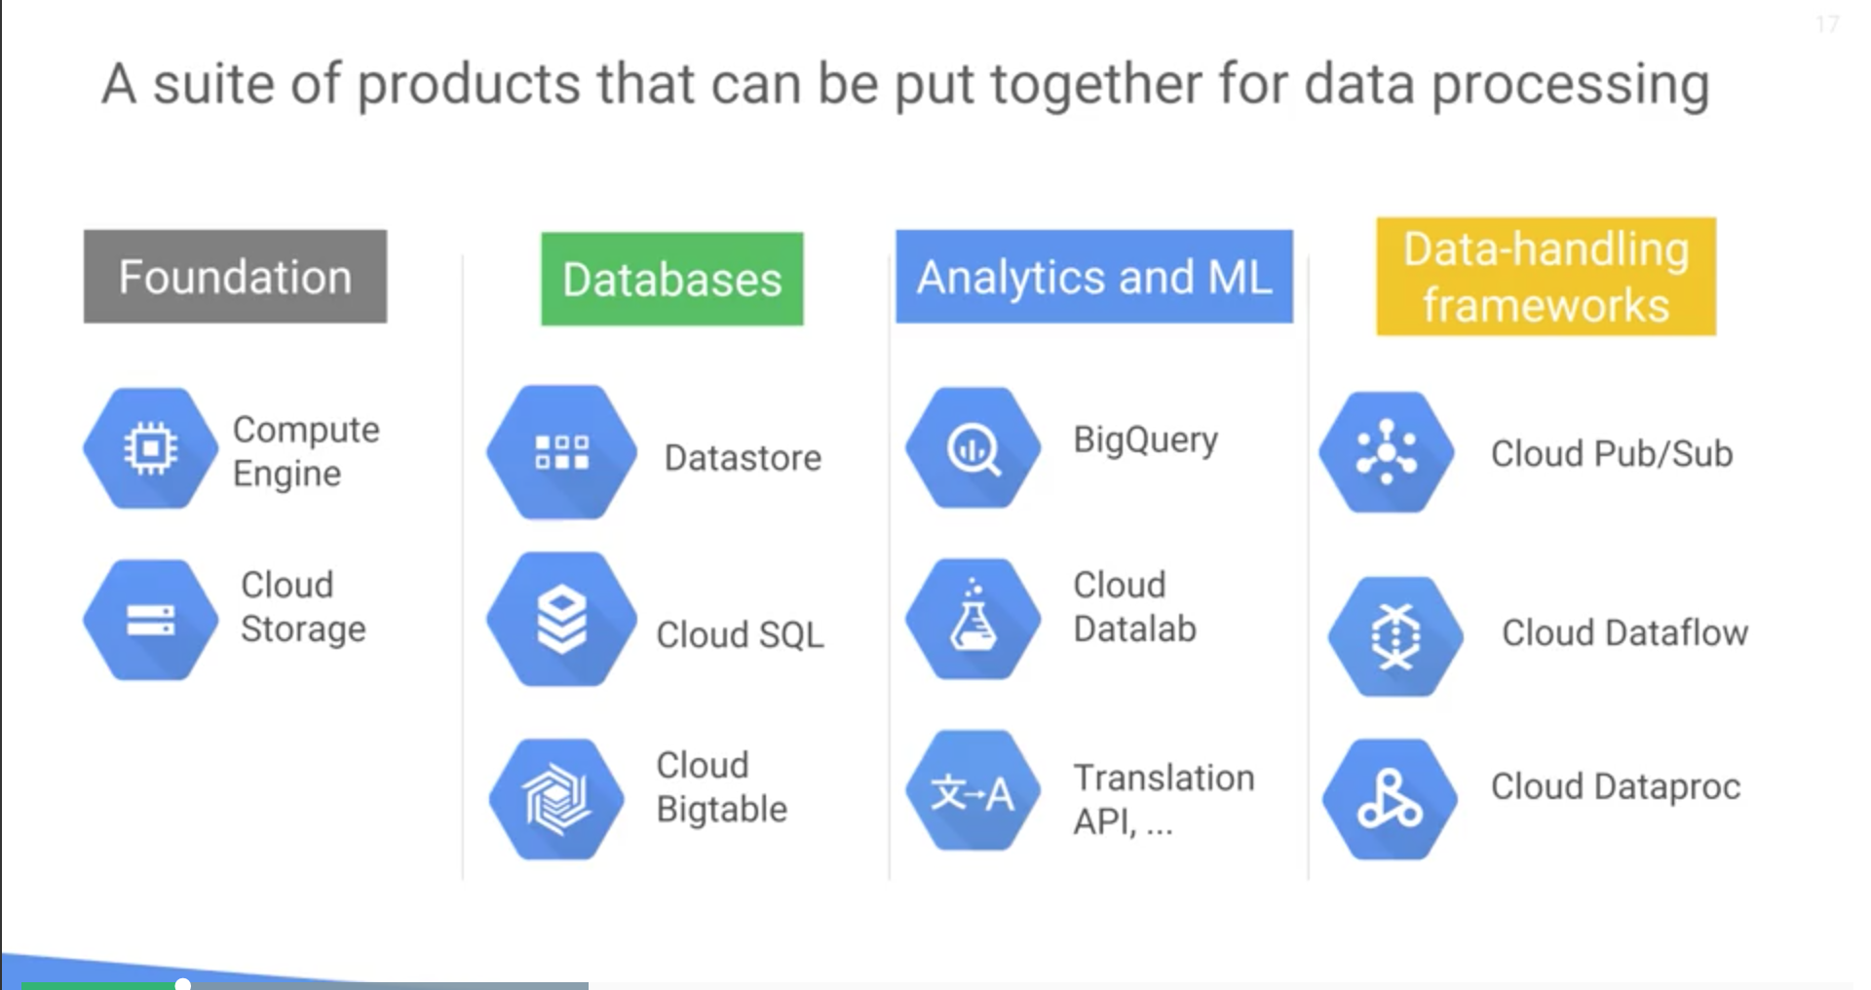
Google Cloud Platform Products

Slide 10
Now the fun part

Slide 11
How can I create a VM instance
Just open the Google Cloud Console
Hit that "Create instance"
Toggle configurations
Remember to allow HTTP/HTTPS traffic
Fire the "Create"

Slide 12
Instances Comparison
Let's see the differences between the 'small' and the 'big' instances during CNN training
Notes:
Small instance
Start VM
Connect ssh
Python
Running code
Big instance
Create instance
More computational power CNN
Comparison Small vs Big

Slide 13
H2O

Slide 14
What's H2O
H2O is an open source Machine Learning platform
Written in Java
Built on top of Map/Reduce framework
Provides a web interface (Flow)
Can be accessed via HTTP remotely
pip install h2o

Slide 15
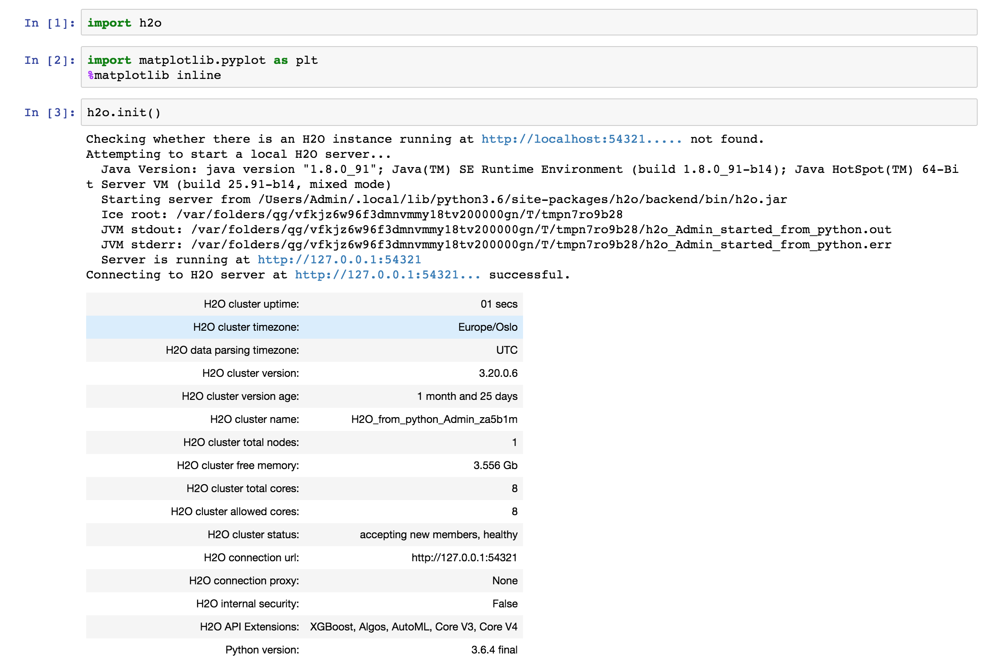
Starting H2O

Slide 16
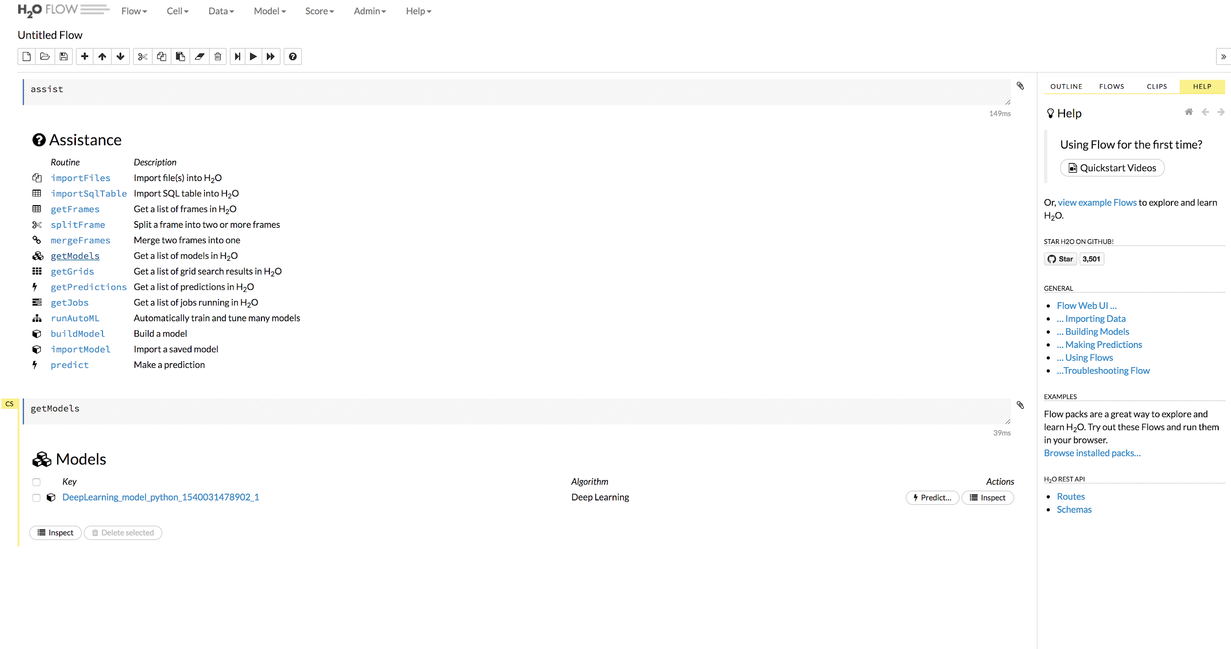
Flow
Flow Documentation
A notebook-style user interface for H2O
Web-based, interactive environment
Provides useful insights of data/models
Flow

Slide 17
Access H2O remotely
H2O instance can be running on another machine
Access it via HTTP protocol
Why should we run H2O on a remote machine?
Performance
Scalability
Constraints, security policies for data accessing
Notes:
Start Flow on a GC Mahcine
Constraints -> access data

Slide 18

Deep Learning with H2O

Slide 19


Thanks :)
Follow me on
https://www.linkedin.com/in/luca-fontanili
https://github.com/lucafon
Or via e-mail
luca.fontanili93@gmail.com

